Slide 1
Using Growth Norms to (in)Validate Years of Learning
Damian Betebenner, Center for Assessment
Charlie DePascale, Psychometric Confections
NCME Annual Meeting
Philadelphia, PA
April 13, 2024

Slide 2
“Time is an illusion” – Einstein
Performance of fourth-grade students on the 2022 NAEP Reading test dropped 7 points from 2018 to the lowest point it has been since 1990.
Educational measurement is arbitrary.
Learning is illusive.
Can we use the illusion to interpret the arbitrary so that we better understand the illusive?
The 8th grade average score of 500 in 2023 is equal to the average score of 6th students in 2019.
Four Perspectives
Semantics
Technical Foundations
Empirical Validation
Utility
Students are two years behind, a half-year behind, six weeks behind…

Slide 3
Semantics: Learning and Time
Learning ≠ Achievement
Learning is a rate: Learning = (Change in Achievement)/Time
Learning is not linear or uniform over time
Learning is inherently an individual activity
Time-based estimates are inherently focused on the group
Time is rarely the most important variable affecting learning
Time is out of favor as a relevant factor when discussing learning or achievement

Slide 4
Semantics: Time-based estimates
We’ve travelled this road before
At their core, there is little difference between today’s time-based estimates and the grade equivalent scores soundly rejected by the measurement field and educators in the NRT era
Prima facie, converting a quasi-interval scale to a ratio scale is akin to psychometric alchemy

Slide 5
Technical Foundations
Measurement is never better than the empirical operations by which it is carried out, and operations range from bad to good. – S.S. Stevens (1946)
Student Response
Vertical Scale Score
Time-Based Estimate
Test
Theta
Score
Scaled Score
Standard Deviation
Effect Size
Even accepting that each individual operation along the way is good, the conceptual and empirical distance travelled is simply too great to support technically sound, interpretable, useful time-based reporting of student test scores.

Slide 6
Empirical Validation
Do the vertical scales we have in education support time based interpretations of learning?
The original question motivating this line of inquiry was:
How common is it to see students making two years worth of learning in a single year?
We used growth norms derived through the SGP framework to answer this question.
To see how we need a little background.

Slide 7
Background
Following Yen (1986) and Dadey and Briggs (2012), cross-grade, effect size is defined as the standardized mean difference between grade x content area means ($g_{1}$) and ($g_{2}$) using the pooled standard deviation:
$$\text{Effect}\text{Size}≡\frac{{\overline{X}}_{g1}−{\overline{X}}_{g2}}{\sqrt{\frac{{\overset{̂}{σ}}_{g1}^{2}+{\overset{̂}{σ}}_{g2}^{2}}{2}}}$$
There are several aspects of this definition worth noting

Slide 8
Background
$$\text{Effect}\text{Size}≡\frac{{\overline{X}}_{g1}−{\overline{X}}_{g2}}{\sqrt{\frac{{\overset{̂}{σ}}_{g1}^{2}+{\overset{̂}{σ}}_{g2}^{2}}{2}}}$$
The effect size associated with a year’s worth of learning is standardized, average distance. That is, it’s largely a normative definition.
To calculate this effect size requires that the numerator be on the same scale so that subtraction makes sense. That is, we require a vertical scale.
The effect size quantifies the extent to which the mean has shifted between the two scaled score distributions.
There will be considerable overlap in the students in $g_{1}$ and $g_{2}$ in most applications of the above Equation to state summative assessment data.
However, there is no requirement that $g_{1}$ and $g_{2}$ consist of the same students (e.g., NAEP).

Slide 9
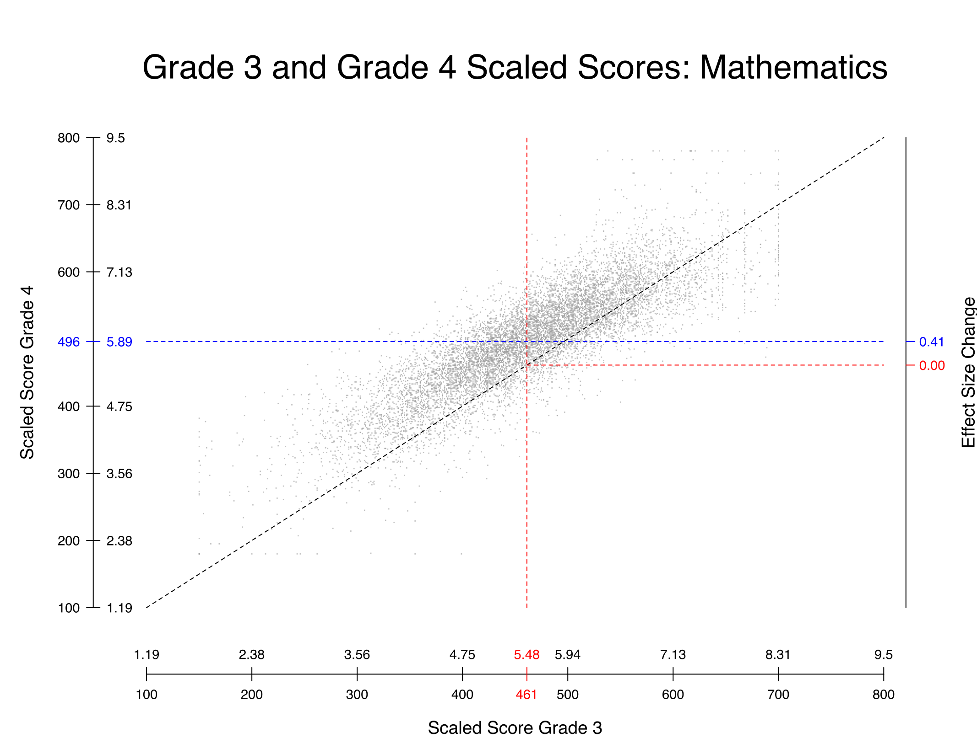
Illustration

Slide 10
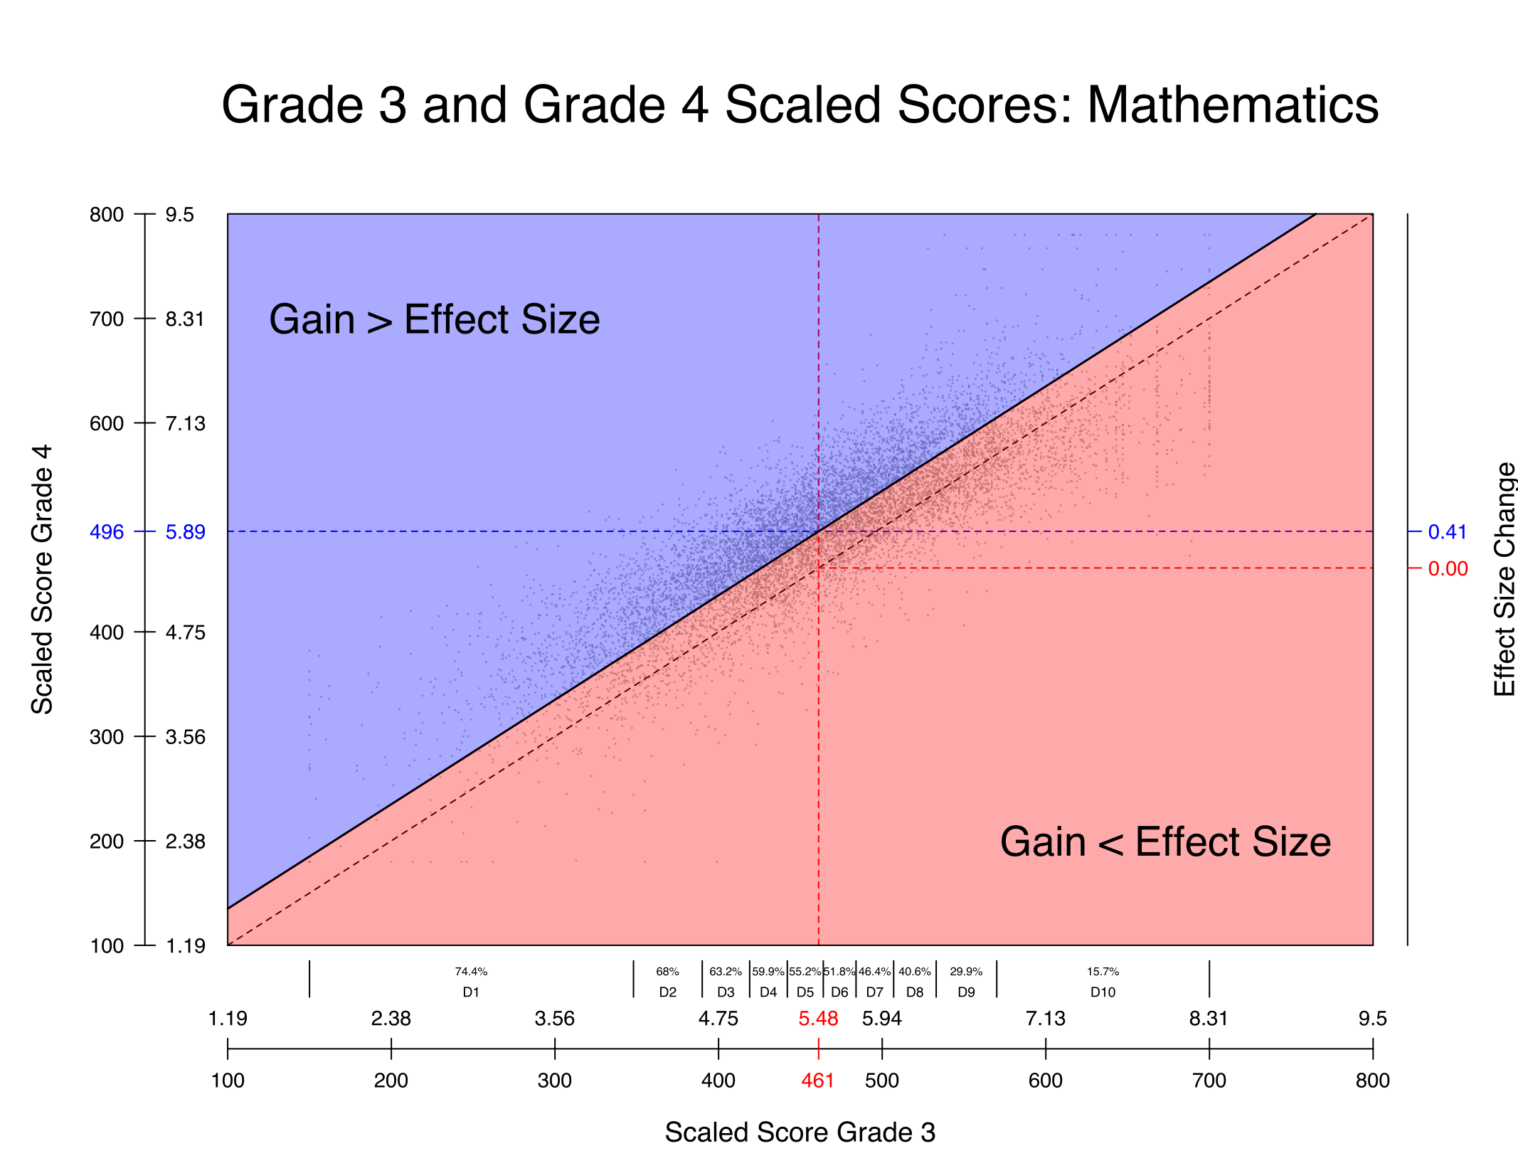
Illustration

Slide 11
Illustration
Note that the effect-size definition of a year’s worth of learning doesn’t translate well to the individual level
Due to the well known negative correlation between prior score and gain, there are large disparities of students making a year’s worth of learning
1st Decile: 74.4%
10th Decile: 15.7%
Using regression we can extend the initial definition to accommodate this.

Slide 12
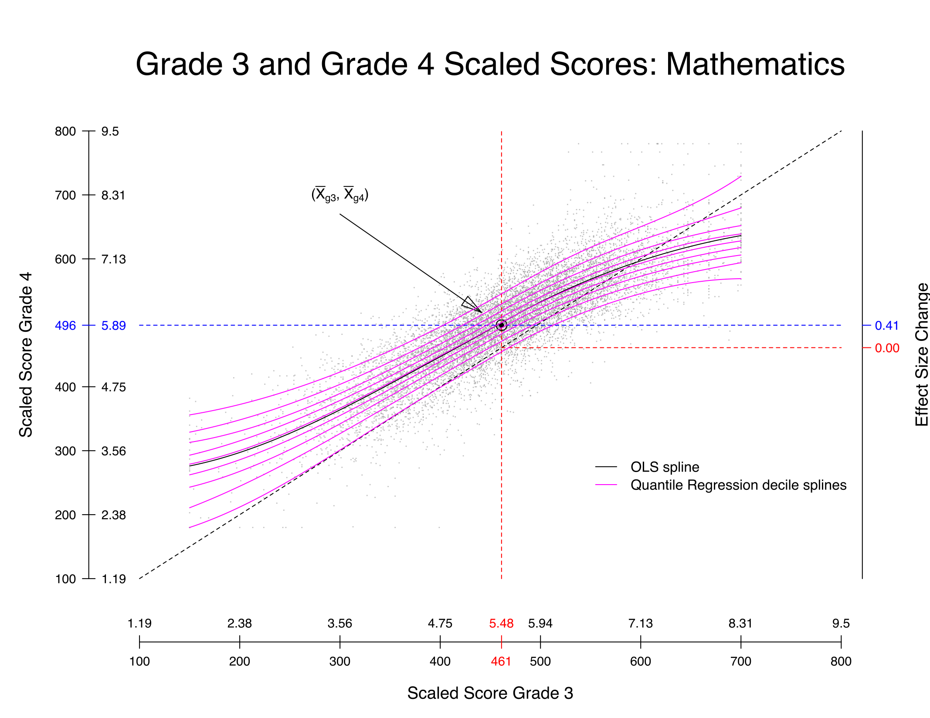
Illustration
The extension of the concept of a year’s worth of learning using the SGP framework sets 50th percentile growth to be a year’s worth of learning.
Note that an SGP is a percentile and indicates a (conditional) probability.
In the year in which the SGP norms are established, 50% of student will be above/below the year of learning threshold

Slide 13
Data & Analyses
We utilize vertically scaled data from 4 different states.
Using this data we create growth norms (coefficient matrices in two ways)
Consecutive grade growth norms (e.g., grade 3 to 4 growth norms).
Growth norms extending across two years (e.g., grade 3 to 5 growth norms)
Using these growth norms we:

Slide 14
Analyses
We calculate SGPs in various ways to determine the probability associated with growth across different time spans using actual, student longitudinal data:
0 Years of Growth: Assume identical scores for students from one grade to the next and feed those data into the 1 year growth norms
2 Years of Growth: Use scores for individual students spanning two years (e.g., grade 3 and grade 5) and feed those data into the 1 year growth norms.
3 Years of Growth: Use scores for individual students spanning three years (e.g., grade 3 and grade 6) and feed those data into the 1 year growth norms.
1/2 Years of Growth: Use scores for individual students spanning one year (e.g., grade 3 and grade 4) and feed those data into the 2 year growth norms.
For example, we wish to know what is the average of the one year SGPs when we feed into growth representing two years of learning for students.
Is two years worth of learning an SGP of 90, 80, 70, …?

Slide 15
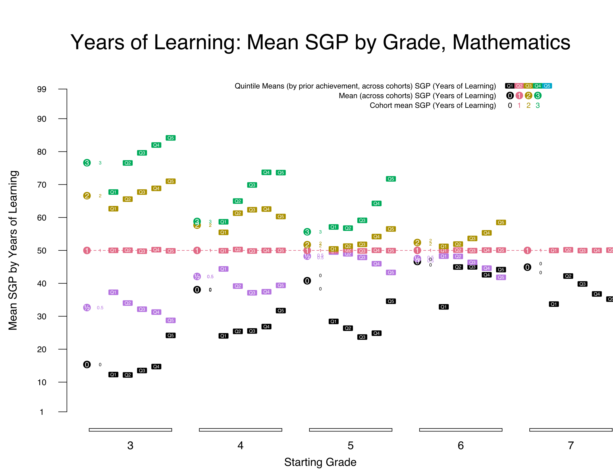
Results

Slide 16
What does this all mean?
The results, in general, are not believable.
For example, from grades 3 to 4, two years worth of learning was observed about 35% of the time.
Put another way, of those students making at least a year’s worth of learning, about two-thirds of them make two or more year’s worth of growth!
The results are more absurd in higher grades!
Our conclusion is that the scales we have cannot support a mapping of elapsed time onto them. They just can’t
That doesn’t mean all is lost.

Slide 17
Is there any hope?
Perhaps a more modest utilization of time is possible without jumping to talking about weeks, months, years of learning.
For example, taking 50th percentile growth as “a year’s worth of learning”, it is likely defensible to produce either a dichotomy or trichotomy:
Dichotomy:
Below a year’s worth of learning.
At/Above a year’s worth of learning
Trichotomy:
Substantially below a year’s worth of learning,
At or Near a Year’s worth of Learning,
Substantially above a year’s worth of learning.

Slide 18



Utility
I used to say, "it is better to be complicated than wrong.” But recently I've relaxed this perspective when engaging with the public about measurement. I'd rather people be interested and learn more than tune out entirely. This comes with risks. I'll accept them. – Andrew Ho (Sept 1, 2022)

Slide 19
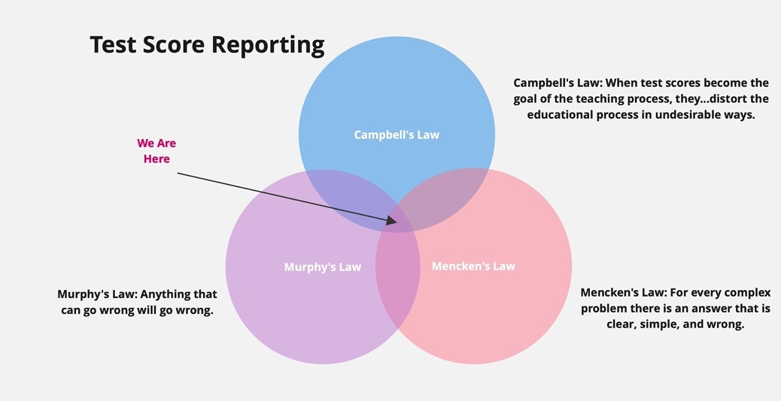

Slide 20
Utility – Problems with Time-based Reporting
Time-based reporting is devoid of content.
Time-based reporting leads stakeholders toward time-based solutions.
The aggregate-level results which are at the core of time-based reporting are not representative of what is taking place at the individual level.

Slide 21


Slide 22
Extra Slides

Slide 23
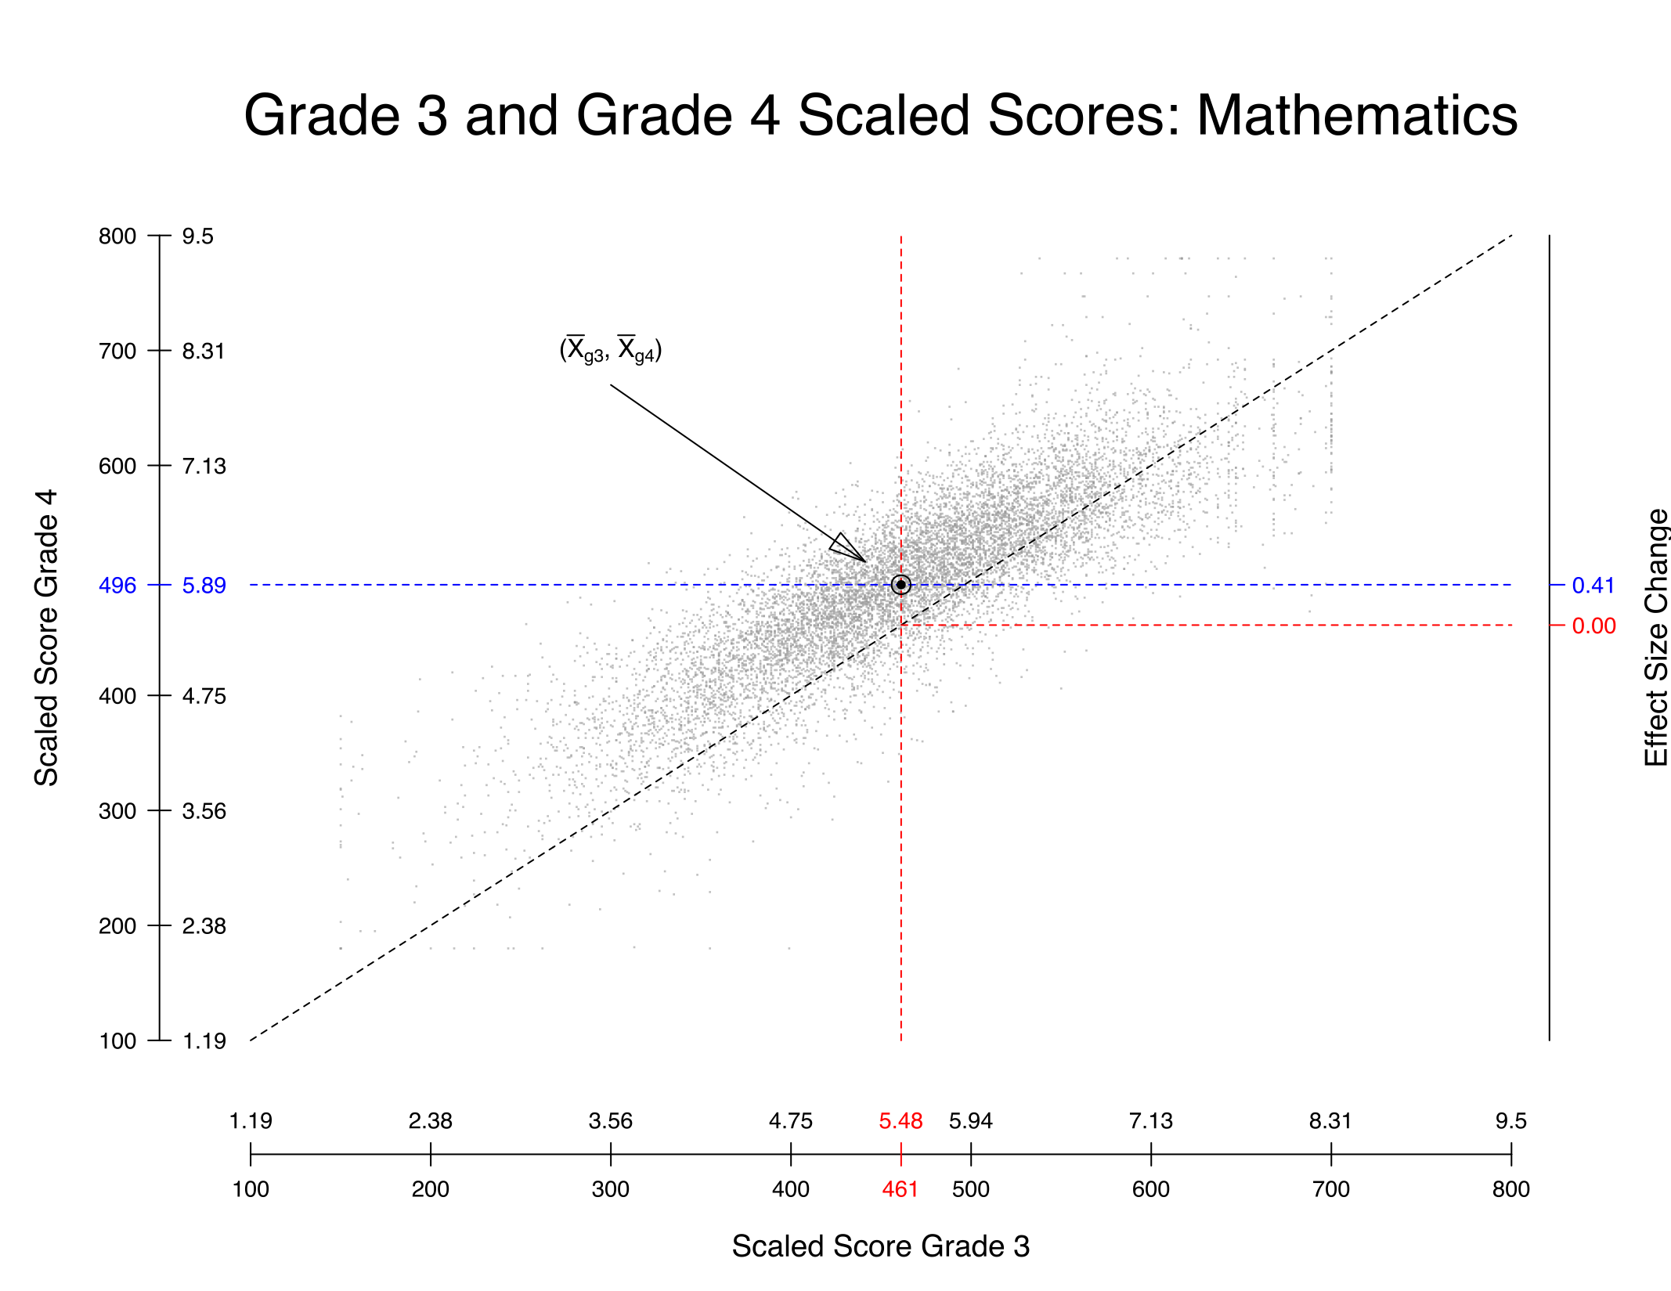
Illustration

Slide 24
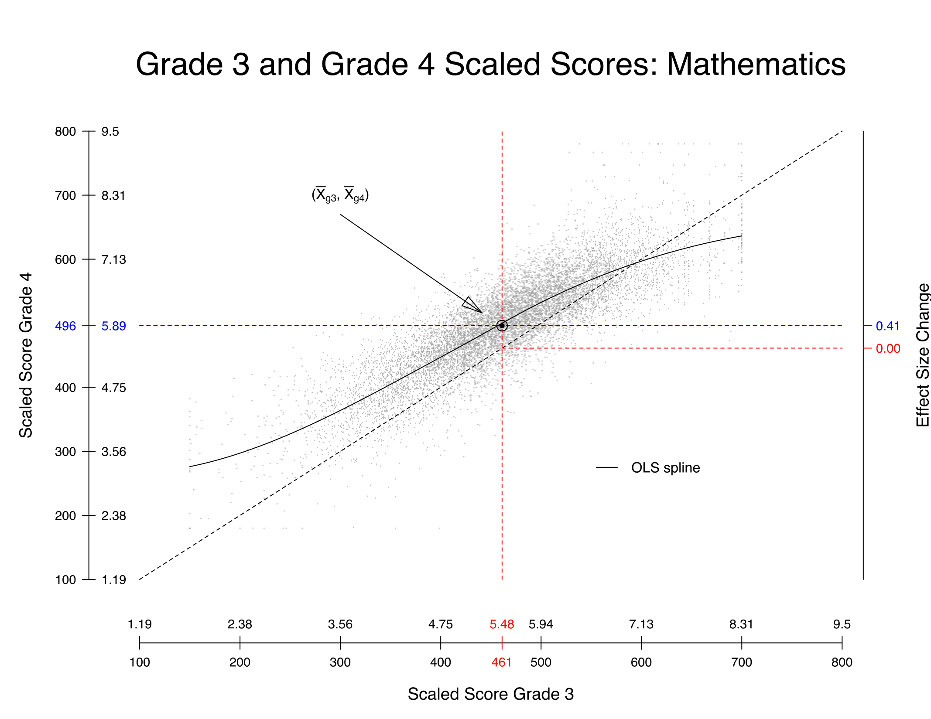
Illustration

Slide 25
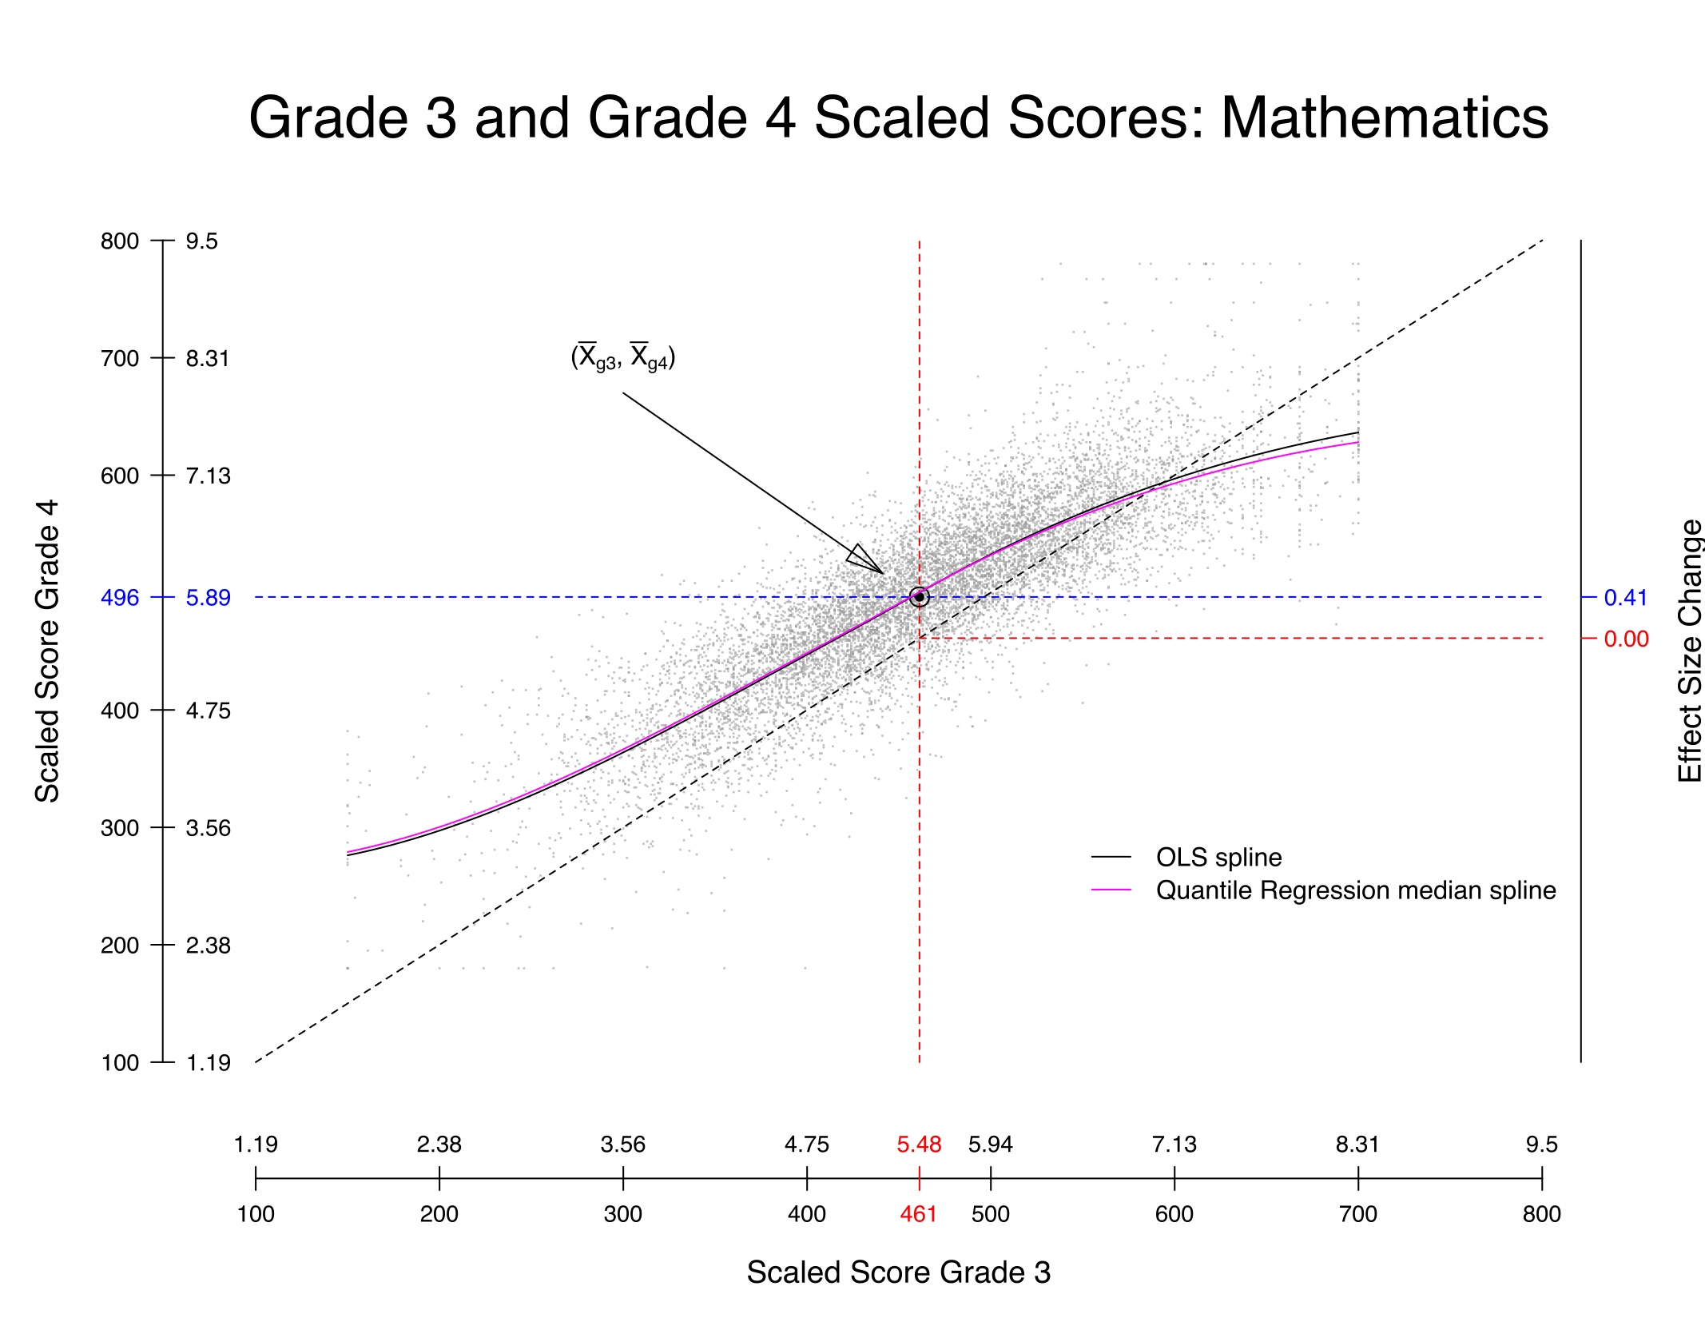
Illustration

Slide 26
Illustration

